Slide 1
Blackout Poems
Found Poems

Slide 2
Blackout Poems
There’s a 250-year old history of folks finding poetry in the daily newspaper.
The poet William Carlos Williams said it was difficult to get the news from poems but it’s not at all hard to get poems from the news.
What’s exciting about blackout poems is that by destroying writing you can create writing.
You can take a stranger’s random words and pick and choose from them to express your own personal vision.

Slide 3
Blackout Poems
How to get started:
In the words of Allen Ginsberg, “shopping for images.”
Begin by looking for a word, or a combination of words, that form a poem/saying/image in your head
The best poems are usually made up of nouns and verbs.
You want an anchor—a place to start. Once you identify the anchor it’s easy to go from there.
Once you find your anchor, you want to move around the page and find words and phrases you can link to the anchor.
Try not to have a preconceived notion of where you want to go. Let the method take you for a ride.
Circle or draw a box around the words and phrases.

Slide 4
Blackout Poems
Do you read the articles first?
NO!
Don’t get swept up in the writing and the stories.
Think of blackout poems like those old “Word Find” and “Word Search” puzzles we used to do in elementary school—a field of letters with hidden messages to find.
Treat the newspaper as raw material.

Slide 5
Blackout Poems
Here’s the recipe:
Grab a newspaper/magazine
Grab a marker.
Find an article.
Cross out words, leaving behind the ones you like.
Pretty soon you’ll have a poem.
THAT’S IT!
You can use any type of newspapers/magazine/books.
Markers: It’s best a fine point tip marker for detail work and a bigger marker for heavy-duty marking.
Most of all have fun.

Slide 6
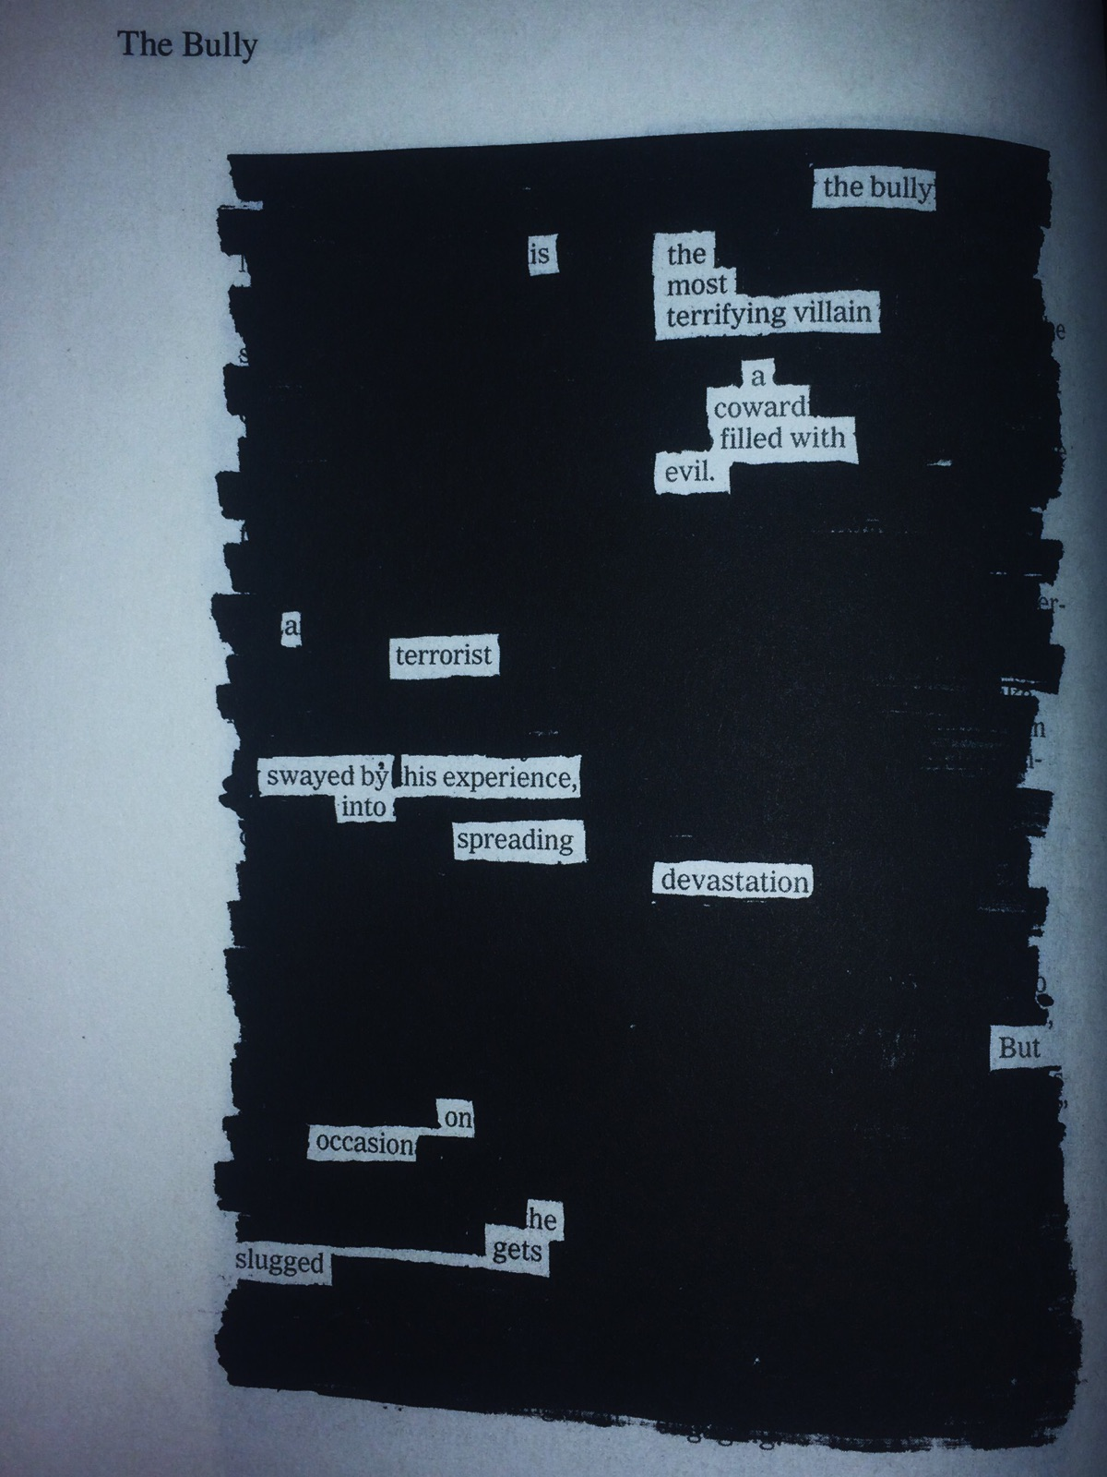

Slide 7
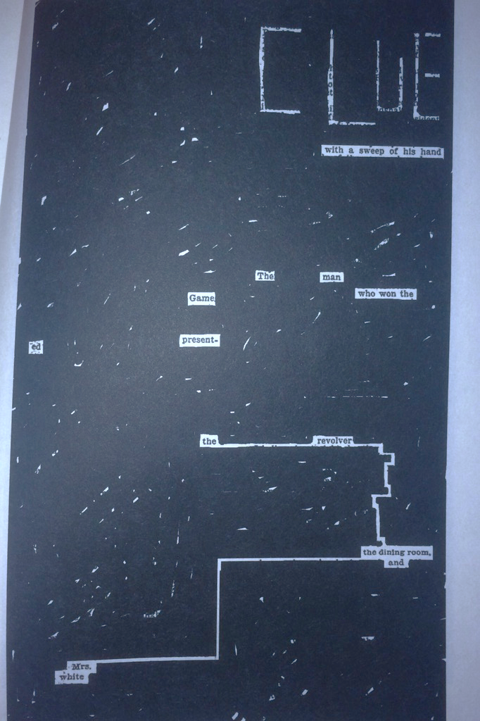

Slide 8
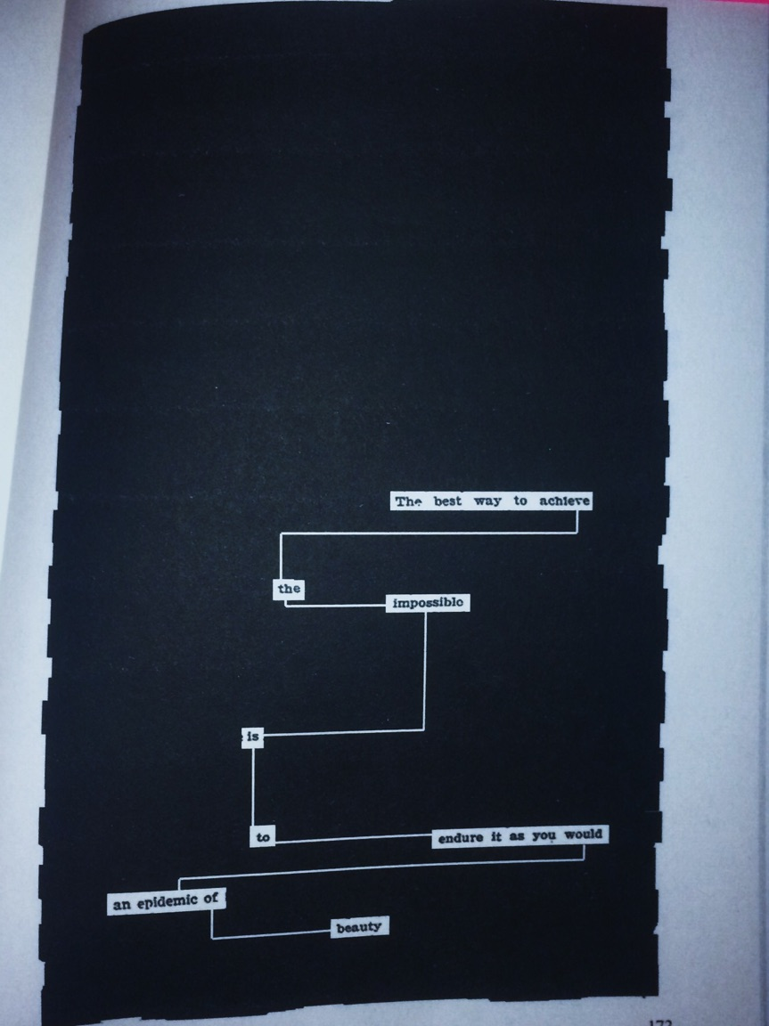

Slide 9
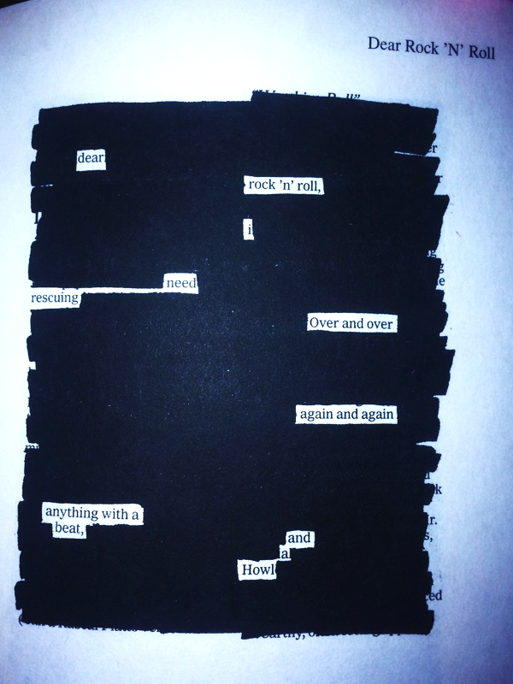
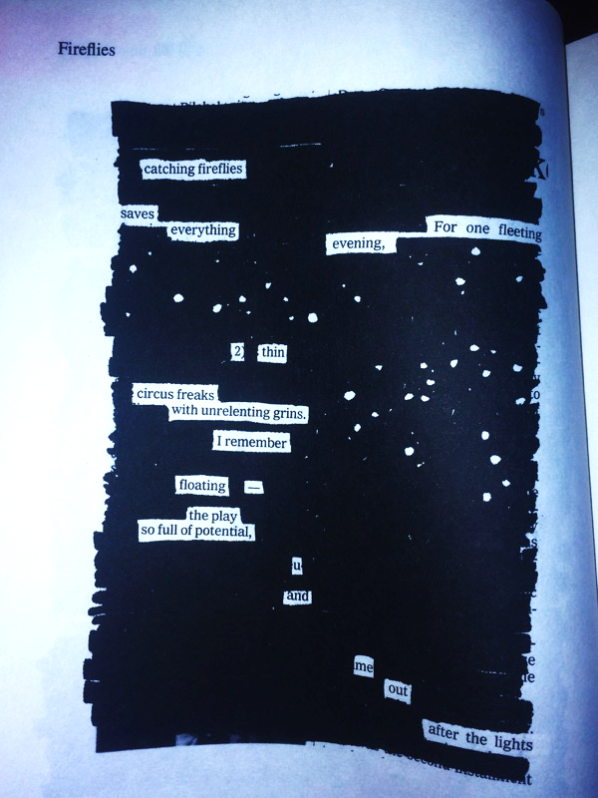

Slide 10
Blackout Poems: Your assignment
You must make five. (Remember poems can vary in size so that’s really not a lot).
Once you have your poems and they’ve been blacked out: cut them out and paste them to a piece of construction paper.
You may find titles for your poems or title them yourselves.
This is due on Friday, May 25th

